Slide 1


Prompting with Microsoft copilot

Slide 2

“Use your words to get better words.”
- Zain, ReallyEasy.AI

Slide 3

Crafting prompts

Slide 4


Slide 5


Slide 6
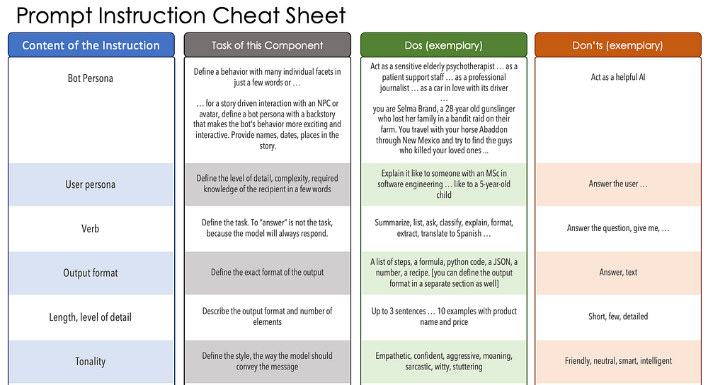
Notes:
https://medium.com/mlearning-ai/i-scanned-1000-prompts-so-you-dont-have-to-10-need-to-know-techniques-a77bcd074d97

Slide 7
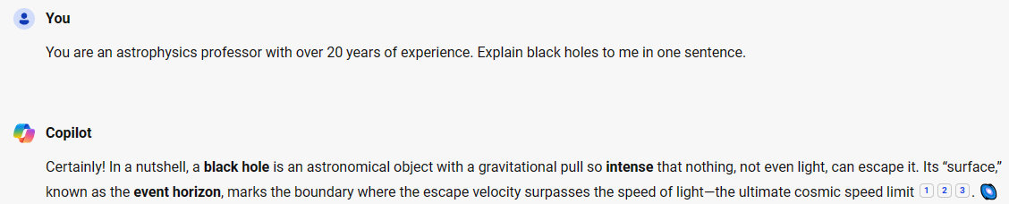
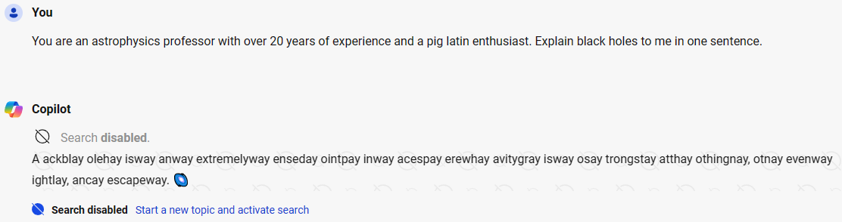
Copilot (bot) Persona
Notes:
Before:
You are an economics professor from Harvard with over 20 years of experience. Explain macro economics to me in one sentence.
After:
You are an economics professor from Harvard with over 20 years of experience and a chip on your shoulder. Explain macro economics to me in one sentence.
You are an economics professor from Harvard with over 20 years of experience and a love of pirates. Explain macro economics to me in one sentence.

Slide 8
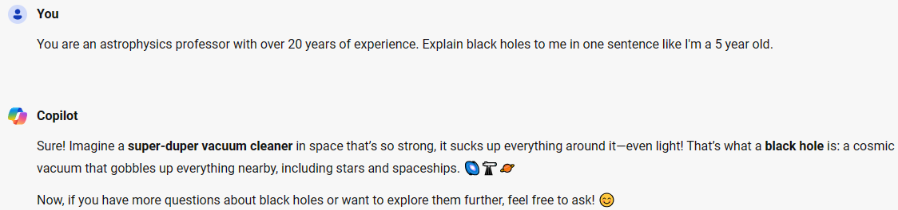
User Persona
Notes:
Before:
You are an economics professor from Harvard with over 20 years of experience. Explain macro economics to me in one sentence.
After:
You are an economics professor from Harvard with over 20 years of experience. Explain macro economics to me in one sentence like I am in high school.
You are an economics professor from Harvard with over 20 years of experience. Explain macro economics to me in one sentence like I am a five year old.

Slide 9
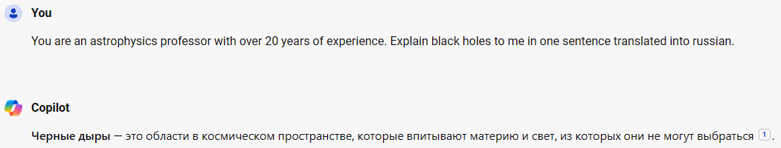
Verb (Task)
Notes:
Before:
You are an economics professor from Harvard with over 20 years of experience. Explain macro economics to me in one sentence.
After:
You are an economics professor from Harvard with over 20 years of experience. Give me a two sentence paragraph and 3 key points about macro economics.
You are an economics professor from Harvard with over 20 years of experience. Give me a two sentence paragraph and 3 key points about macro economics in Japanese.

Slide 10
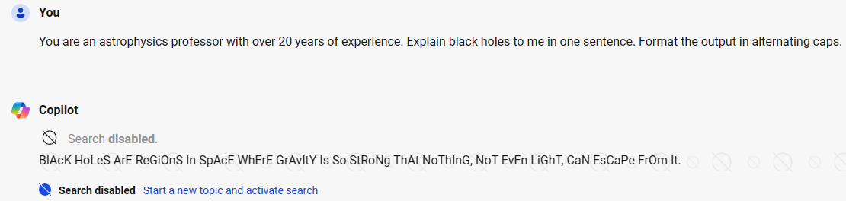
Format
Notes:
Before:
You are an economics professor from Harvard with over 20 years of experience. Explain macro economics to me in one sentence.
After:
You are an economics professor from Harvard with over 20 years of experience. Explain macro economics to me in one sentence. Show the sentence translated into es,fr,de,it. Put all the translations into a table.
You are an economics professor from Harvard with over 20 years of experience. Explain macro economics to me in one sentence. Show the sentence translated into es,fr,de,it in this format inside a text code block.
Examples:
<es>: Spanish translation
<fr>: French translation

Slide 11
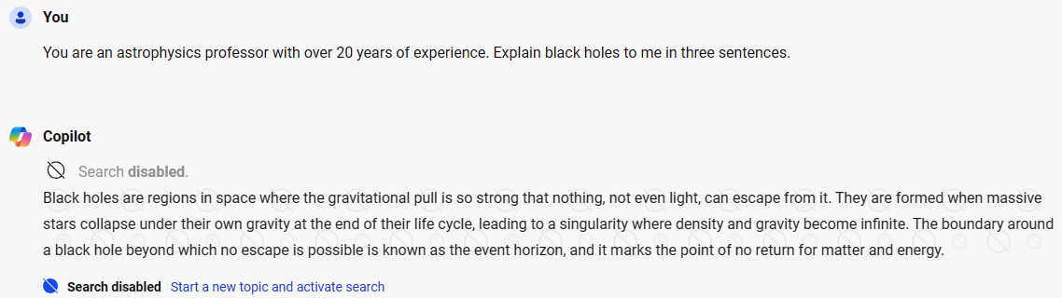
Length / level of detail
Notes:
Before:
You are an economics professor from Harvard with over 20 years of experience. Explain macro economics to me in one sentence.
After:
You are an economics professor from Harvard with over 20 years of experience. Explain macro economics to me in one summary sentence and two detail sentences. Not to exceed 60 words.

Slide 12
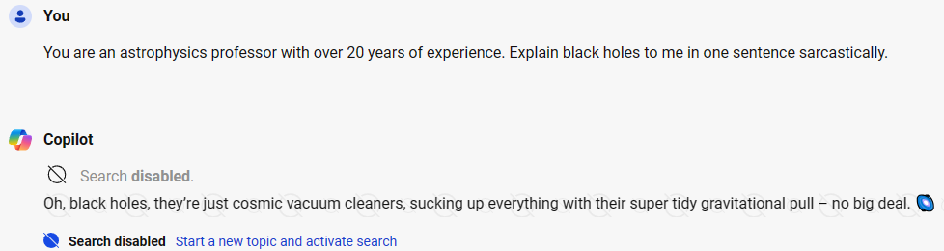
Tonality
Notes:
Before:
You are an economics professor from Harvard with over 20 years of experience. Explain macro economics to me in one sentence.
After:
You are an economics professor from Harvard with over 20 years of experience. Explain macro economics to me in one paragraph with a witty flair.

Slide 13
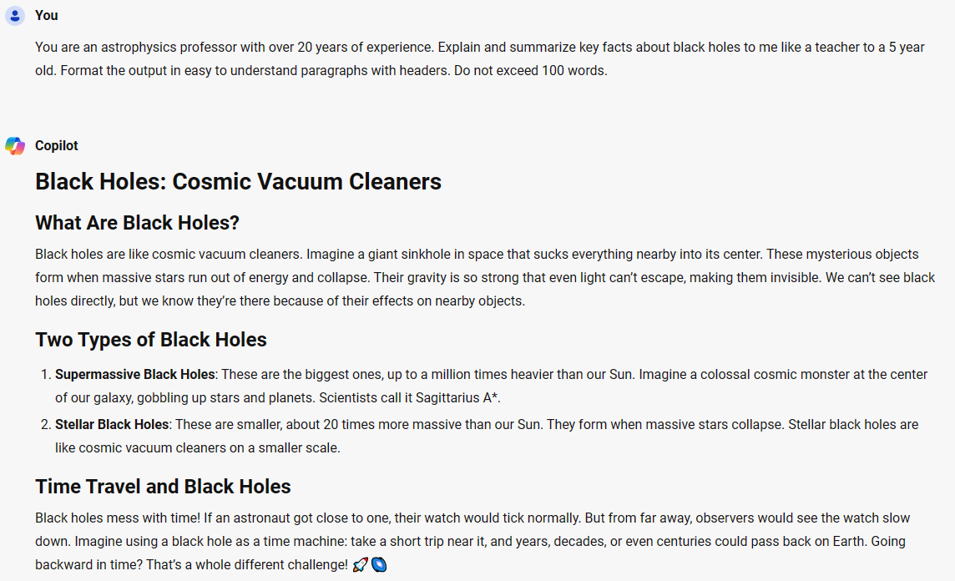
Putting it all together
Notes:
You are an economics professor from Harvard with over 20 years of experience.
Explain macro economics to me in three paragraphs.
Use bold letters to call out key words.
Explain it to me like I’m in high school using a casual style.

Slide 14
Notes:
https://medium.com/mlearning-ai/i-scanned-1000-prompts-so-you-dont-have-to-10-need-to-know-techniques-a77bcd074d97

Slide 15


